Slide 1


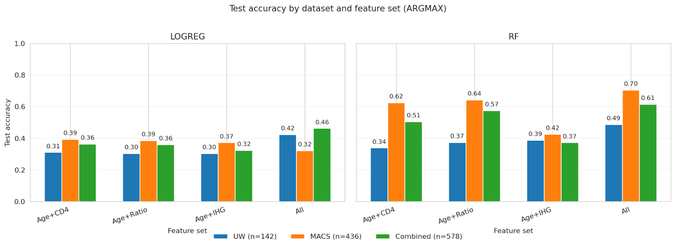
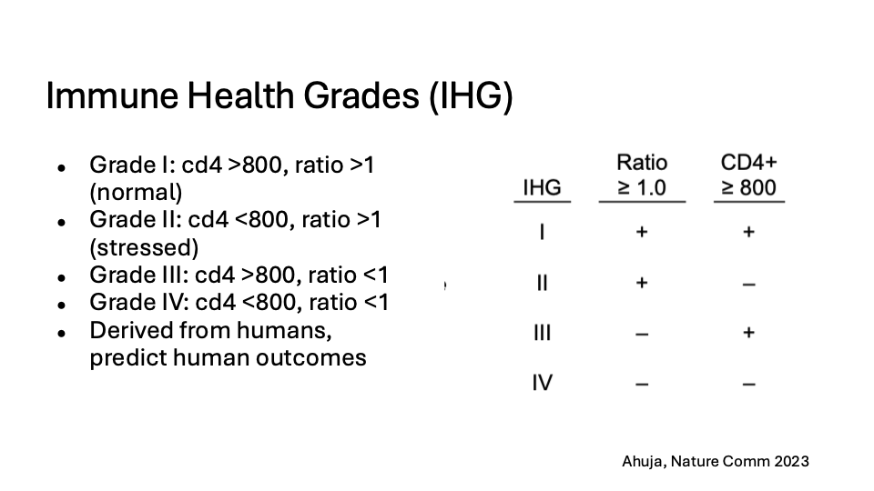
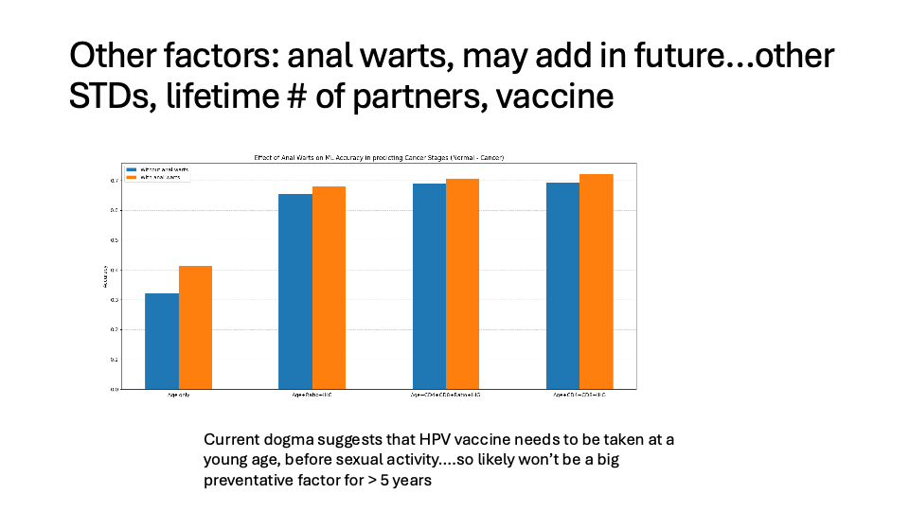
AI Model using immune parameters to predict dysplasia and guide decisions on anal cancer screening
John Aradan ¹, Nabil S. Hussaini¹, Anna Field¹, Elebeoba May¹, Jacqueline Miller¹, Amir Forati¹, Jing Sun², Ken Ho³, Matthew Mimiaga⁴, Frank Palella⁵, Ryan Herrschaft², Gypsyamber D’Souza², and Rob Striker¹
¹University of Wisconsin–Madison, WI 53706, USA, ²Johns Hopkins University, Baltimore Maryland, ³University of Pittsburgh, ⁴ University of California-Los Angeles, ⁵ Northwestern University
ABSTRACT
RESULTS
Background: The ANCHOR study demonstrated that aggressive anal cancer screening and treatment can prevent progression to malignancy. High Resolution Anoscopy (HRA), however, is invasive and resource-intensive, and risk is not evenly distributed among people living with HIV (PLWH). Individuals with poor immune recovery remain at highest risk.
Methods: We analyzed 400 PLWH from the UW clinic (2000–2020) and 1,200 participants from the Multicenter AIDS Cohort Study (MACS, 1984–2025). All had anal cancer screening results (cytology or biopsy) with concurrent immune measures: CD4, CD8, CD4/CD8 ratio, and Immune Health Grades (IHG), integrating CD4 and CD4/CD8 ratio. Outcomes were categorized as no disease, LSIL, HSIL, or anal cancer. A pipeline of supervised classifiers was trained on 80% of the data (stratified by outcome) and tested on 20%, with an additional 10-fold cross-validation. Feature sets were incrementally expanded: age + CD4, age + CD4/CD8 ratio, age + IHG, and all immune parameters. Performance was assessed by accuracy, sensitivity, specificity, balanced accuracy, and multiclass AUC. Model comparisons used McNemar’s test and bootstrap resampling to generate 95% confidence intervals. Confusion matrices were reviewed to characterize misclassification, with emphasis on differentiating LSIL/HSIL from normal and cancer.
Results: Predictive accuracy improved with additional immune features. In the combined dataset, age + CD4 achieved 0.61 accuracy (95% CI: 0.58–0.64), while the classifier with all parameters reached 0.73 (95% CI: 0.70–0.76; p<0.01). Cross-validation confirmed stability, and bootstrap analysis supported significance. Normal cytology and invasive cancer were identified with highest accuracy, while LSIL and HSIL were more frequently misclassified, largely with each other. Cohort-specific analyses showed accuracy gains from 0.41 to 0.52 in UW and from 0.69 to 0.80 in MACS.
Conclusions: Immune parameters measured at the time of screening significantly improve prediction of anal disease in PLWH beyond CD4 alone. Multivariable models consistently outperformed standard approaches, particularly for distinguishing lowest- and highest-risk individuals. These findings support immune-based risk stratification as a strategy to refine screening intensity and reduce unnecessary HRA. Ongoing work will integrate additional clinical predictors and translate these models into a web-based tool for personalized, less invasive screening
Current Model Accuracy using Logistic Regression or Random Forest
Log Reg Random Forest
DISCUSSION
FUTURE DIRECTIONS
We know more data will improve accuracy, but our goal is to maximize accuracy while minimizing complexity and having clinicians add in work intensive data. Factors to be added in include nadir/ prior immune parameters, anal warts, HPV vaccine, lifetime # of sex partners, smoking and other sexually transmitted diseases.
To determine the utility of AI models in anal cancer/dysplasia prediction once a more complete data set is determined. We will prospectively test the model in VA hospitals in Dallas, Atlanta and Tampa Bay both in veterans living with HIV and on PrEP.
These results hold contextual importance in the landscape of anal cancer progression in recent years. In the late 1990s, anal cancer was less common and often associated with low CD4 counts. Emerging into the 2000s as anal cancer became more prevalent and ART started earlier and CD4 counts were often higher. The shifts in CD4 counts could impact model estimates due to samples being collected from 2000 to 2020⁴.
This work and our earlier work from the Madison and National VA data sets show that while there is some correlation with Absolute CD4, but the CD4/CD8 ratio, particularly the nadir ratio is the strongest predictor. Results here though rely on data at the time of diagnosis as it is more available. Additional data will be added in….
METHODS
Several model formats available from were considered initially including a Markov model, vectored models, and a random forest model. Ultimately a random forest model was settled on. Regression and machine learning models were used to evaluate whether immunologic parameters improved prediction of cytology outcomes beyond age and CD4 count. The merged UW and MACS dataset included 1,790 observations with complete information on age at visit, CD4 and CD8 T-cell counts, CD4/CD8 ratio, Immune Health Grade (IHG; grades I–IV), history of warts, and a four-level cytology outcome (Normal, LSIL, HSIL, Cancer). Four prespecified feature sets were examined: (1) Age + CD4, (2) Age + CD4/CD8 ratio, (3) Age + IHG, and (4) a full set including Age, CD4, CD8, ratio, IHG.
For prediction, the data were split into training and test sets using a group-aware split that preserved the distribution of cytology categories and study site. Multinomial logistic regression served as a linear baseline model, and a random forest classifier represented a nonlinear ensemble approach. Within the training data, three-fold cross-validation was used for hyperparameter tuning, targeting balanced accuracy to account for class imbalance. For logistic regression, an ℓ2-penalized model with balanced class weights was fit over a wide range of regularization values, and the final model used the value of C that maximized cross-validated balanced accuracy. For the random forest, the number of trees, maximum depth, and class weighting scheme were tuned in the same cross-validation framework; the final model used a large ensemble of trees with constrained depth and “balanced” subsampling of classes. After tuning, both models were refit on the full training set and then evaluated, without further adjustment, across all four feature sets.
Complete Data set of Patients with HIV and clinical diagnosis
ACKNOWLEDGEMENTS & REFERENCES
Diagnosis | UW | MACS
No disease | 230 | 1040
LSIL | 131 | 218
HSIL | 93 | 28
Cancer | 17 | 33
References
Karim, A. et al. Duration of Time CD4/CD8 Ratio is Below 0.5 is Associated with Progression to Anal Cancer in
Patients with HIV and High-Grade Dysplasia. Ann Surg Oncol (2023) doi:10.1245/s10434-023-13213-z.
Stem, J., Yang, Q., Carchman, E., Striker, R. & Sanger, C. B. Do immune inflammatory markers correlate with anal dysplasia and anal cancer risk in patients living with HIV? Int J Colorectal Dis 37, 983–988 (2022).
Sanger, C. B. et al. Prevalence of High-Grade Anal Dysplasia and Anal Cancer In Veterans Living With HIV And CD4/CD8 Ratio As A Marker For Increased Risk: A Regional Retrospective Cohort Study. Dis Colon Rectum 64, 805–811 (2021).
Diamond, C., Taylor, T. H., Aboumrad, T., Bringman, D. & Anton-Culver, H. Increased Incidence of Squamous Cell Anal Cancer Among Men With AIDS in the Era of Highly Active Antiretroviral Therapy. Sexually Transmitted Diseases 32, 314 (2005).
(IRB #2025-0390)

